Slide 1
FPGA implementation of an HDMI converter for serial high speed transmission
Marisa Oliveira
Master Thesis in Electrical and Computer Engineering

Slide 2
Content
Project Overview
Motivation
Equipment Used
Goals
Project Development and Results
Step 1
Generating Color Bar in FPGA and communicating it to HDMI source
Simple communication of image between HDMI devices
Simple communication of image and sound between HDMI devices
Step 2
Serial communication of a Color Bar Image generated in FPGA and HDMI source
Serial communication of image between HDMI sink and source
Future Work

Slide 3
Project Overview

Slide 4
Project Overview
Motivation
Need for High Speed Connections VS Multimedia Interface Security

Slide 5


Project Overview
Motivation
Need for High Speed Connections
VS
Multimedia Interface Security

Slide 6
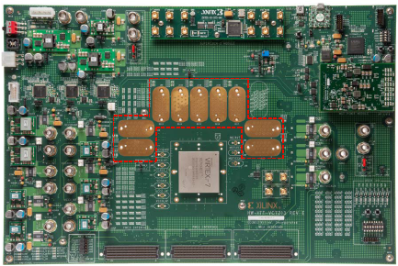
Project Overview
Equipment Used
FPGA VC7203
“Field-Programmable gate array”
Programmable device to develop and implement design
FMC connectors: transmit parallel data with a data rate up to 2 Gb/s (per channel)
GTX transceivers : transmit serial data up to 12,5 Gb/s
GTX transceivers
FMC connectors

Slide 7
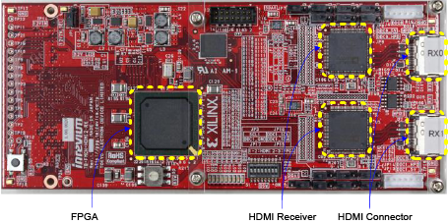
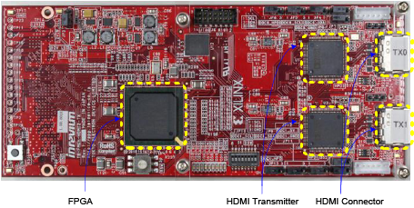
Project Overview
Equipment Used
TB-FMCH-HDMI2
Receiver (image above) and Transmitter (Image below)
Receive and transmit data from sink and source
Integrated FPGA with 3 different configurations available
Connection to VC7203 FPGA through FMC connectors
GTX transceivers

Slide 8
Project Overview
Goals
Obtain a reliable communication between two HDMI devices:
Connect HDMI sink device with HDMI receiver board through an HDMI cable
Implement a design in the FPGA to receive data from HDMI board
Create packets of the incoming data and send it to the GTX transmitter
Receive the incoming data from the GTX receiver and re-organize it
Finally send it again to the HDMI transmitter board which is connected to the HDMI source device through an HDMI cable

Slide 9
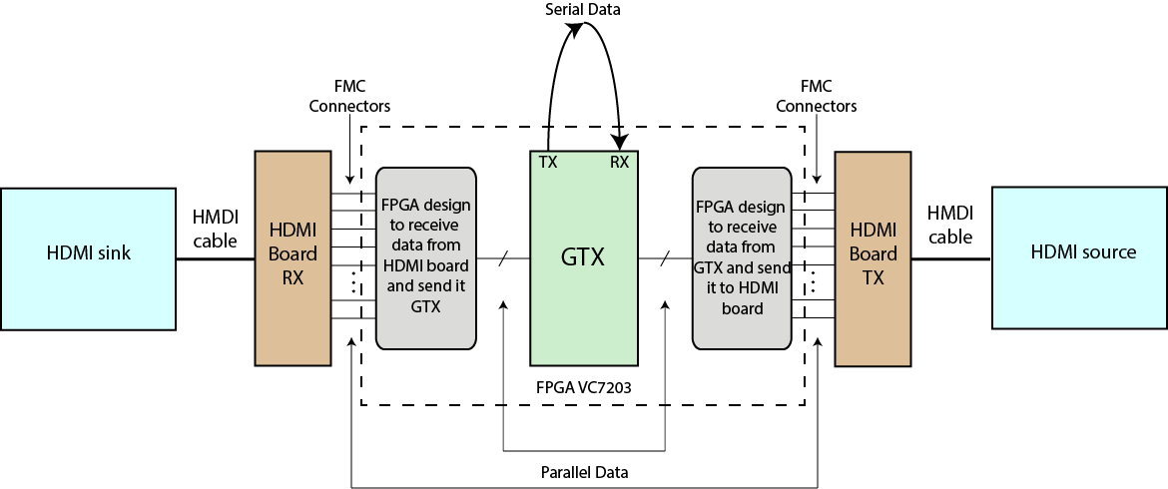
Project Overview
Goals
3
4
1
6
2
5

Slide 10
Project Overview
Goals
Goal
Step 1
Step 2
Project divided in two steps
Step 1: Obtain simple and direct communication between two HDMI exploring the boards different configurations
Step 2: Create a serial protocol and a design in the FPGA in order to connect data to GTX transceivers available in the FPGA

Slide 11
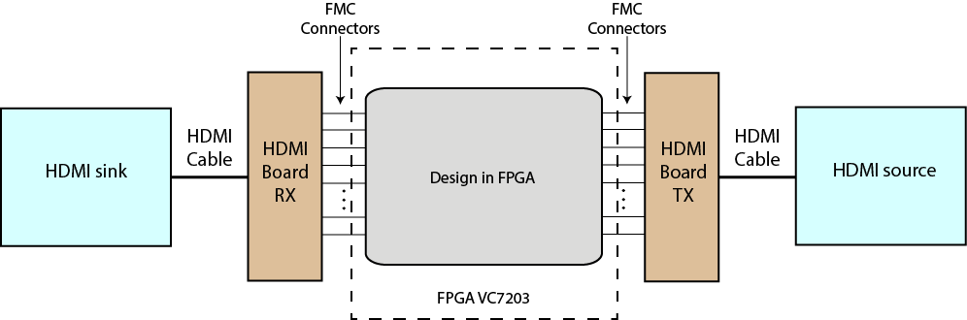
Project Overview
Goals – Step 1

Slide 12
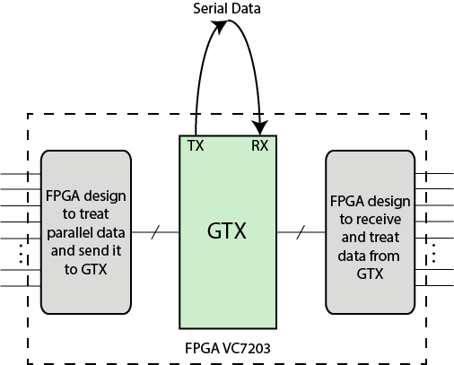
Project Overview
Goals – Step 2

Slide 13
Project Development
And some results

Slide 14
Step 1 - Development
Generating COLOR BAR in FPGA and communicating it to HDMI source

Slide 15
Step 1 - Development
Simple communication of image between hdmi devices

Slide 16
Step 1 - Development
Simple communication of image AND SOUND between hdmi devices

Slide 17
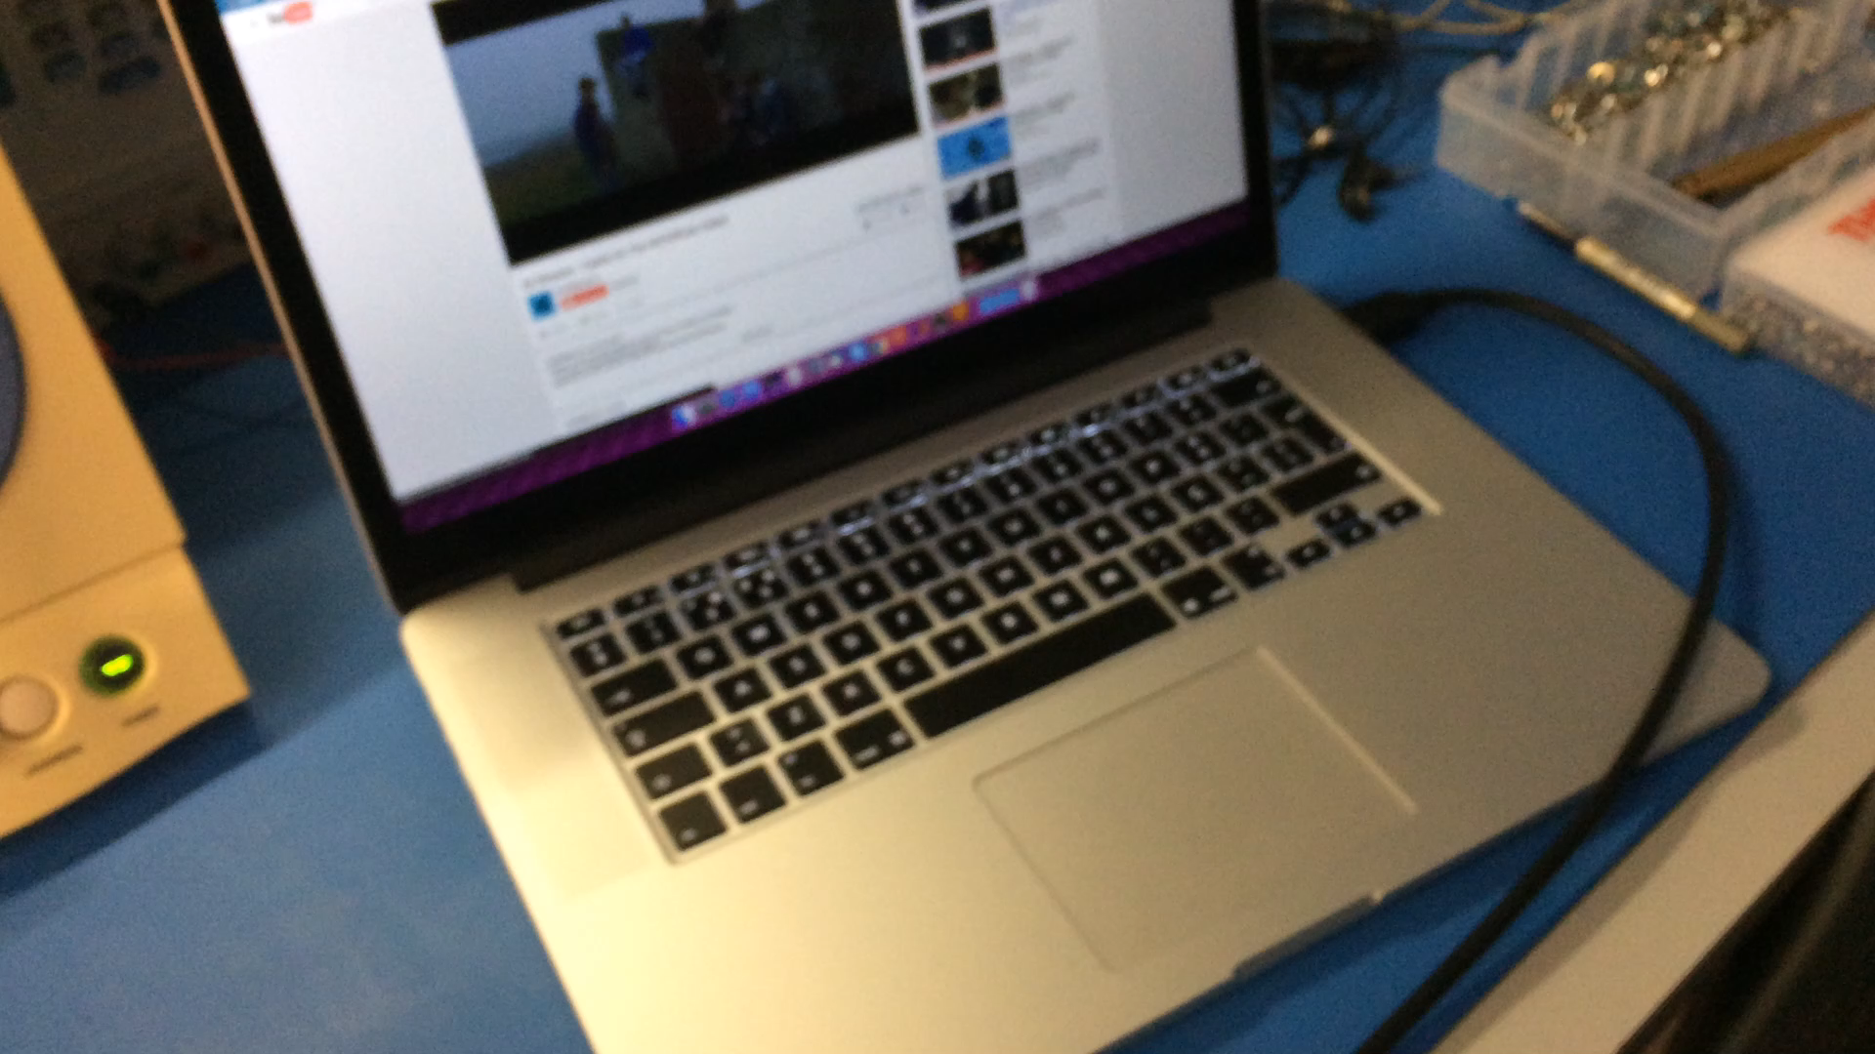
Step 1 - Results
Simple communication of image AND SOUND between hdmi devices

Slide 18
Step 2 - Development
Serial communication of COLOR BAR generated in FPGA and HDMI source

Slide 19
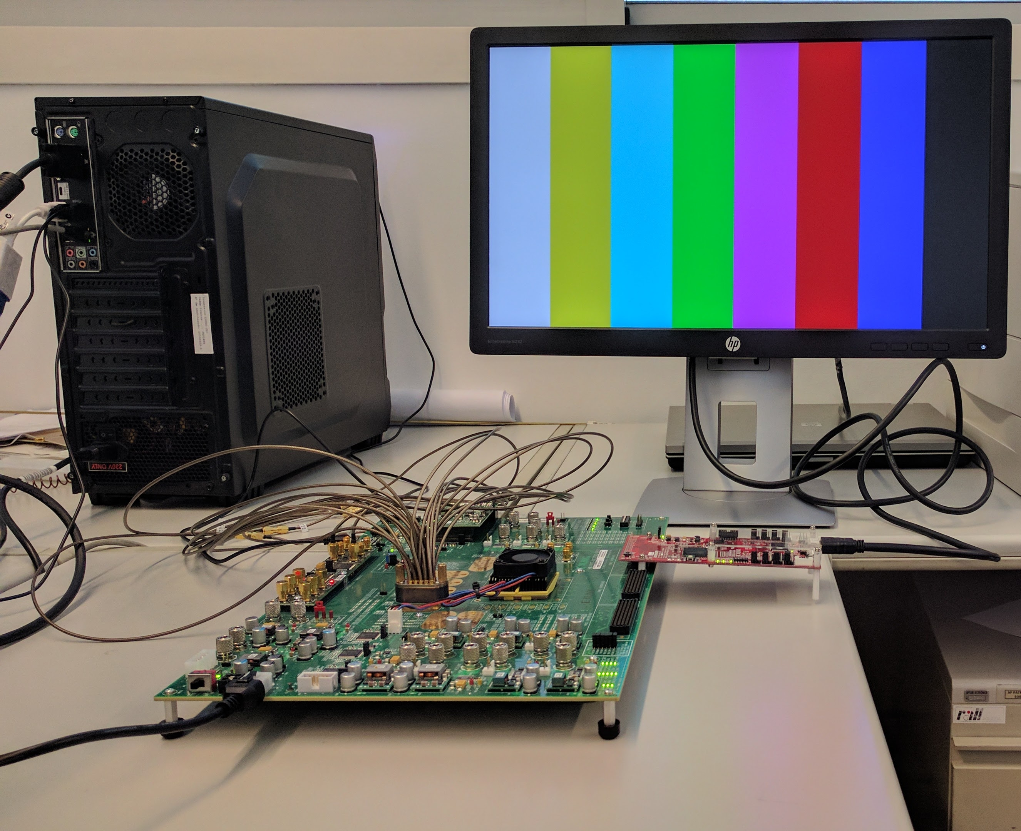
Step 3 - Results
Serial communication of a Color Bar Image generated in FPGA and HDMI source

Slide 20
Step 2 - Development
SERIAL COMMUNICATIAN OF AN IMAGE BETWEEN HDMI SINK AND SOURCE

Slide 21
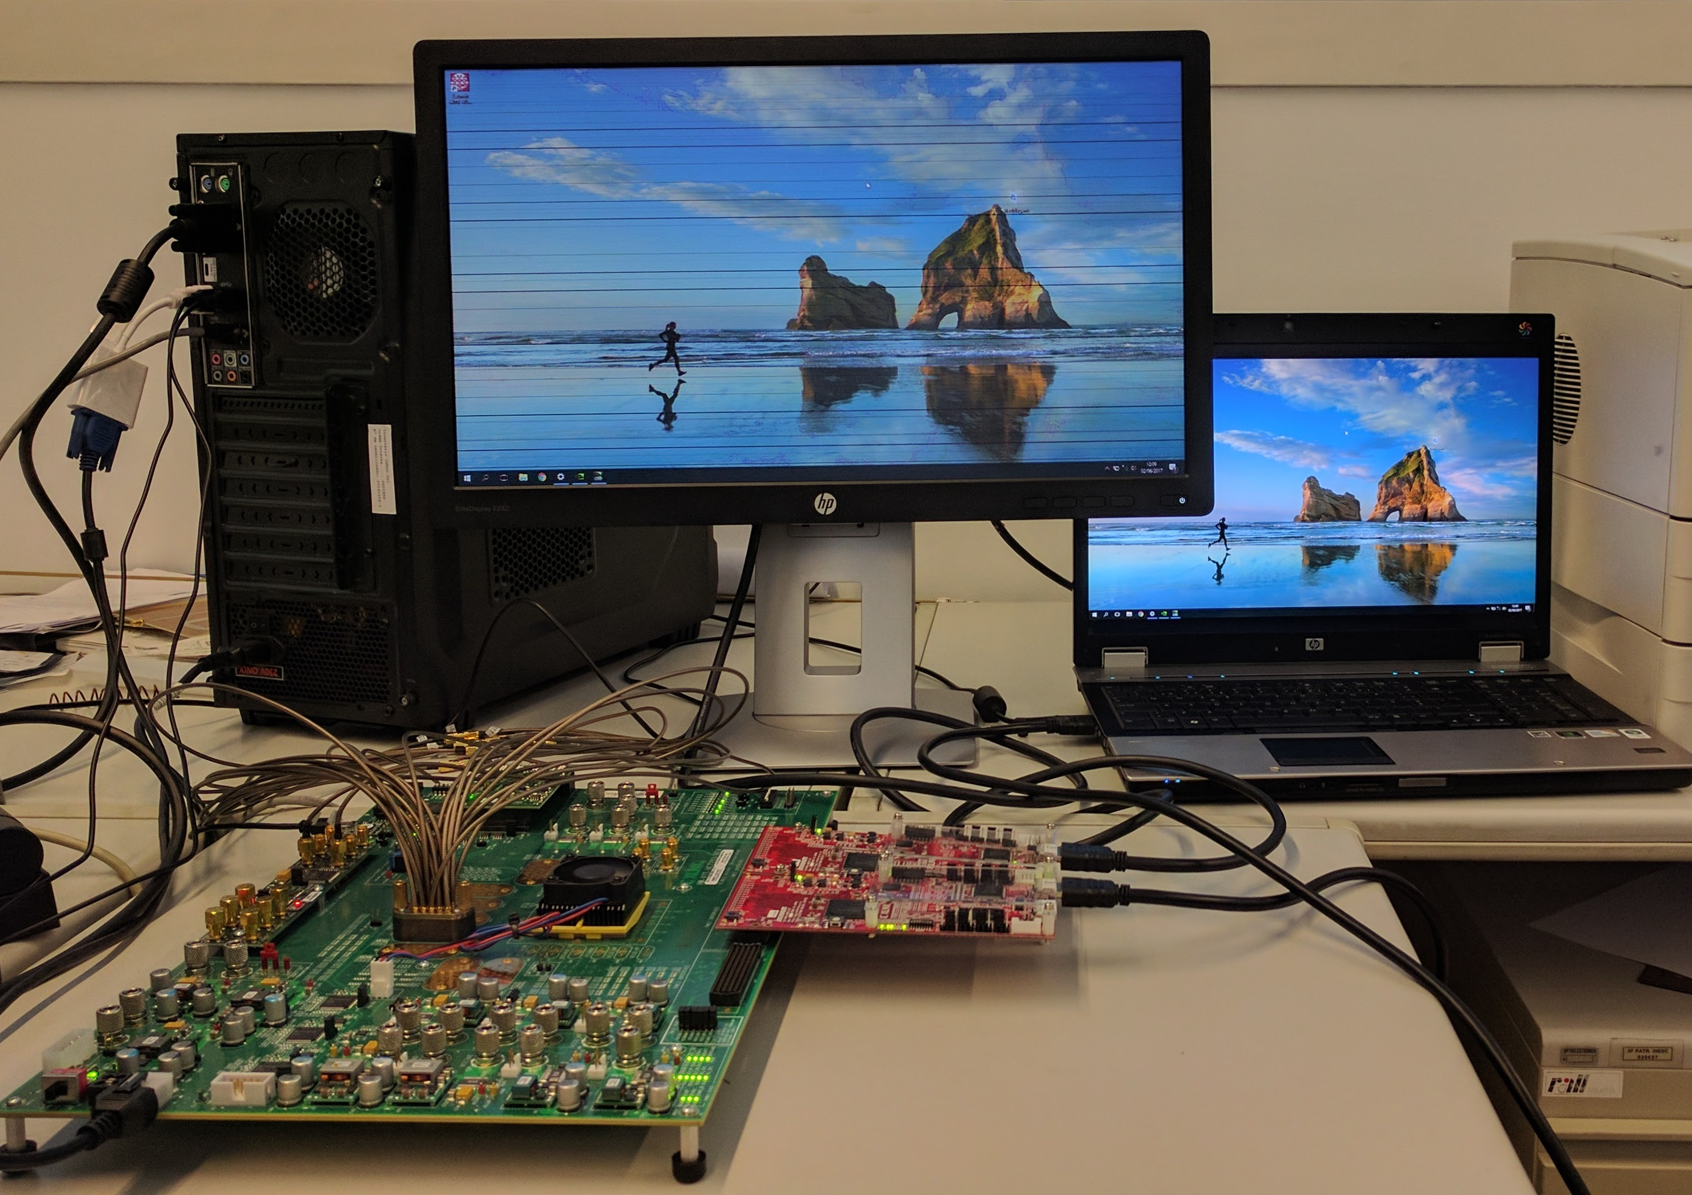
Step 2 - Results
SERIAL COMMUNICATIAN OF AN IMAGE BETWEEN HDMI SINK AND SOURCE

Slide 23
Conclusions
And future work

Slide 24
Add a Slide Title - 4

Slide 25
Thank you
Any Questions ?

